Slide 1
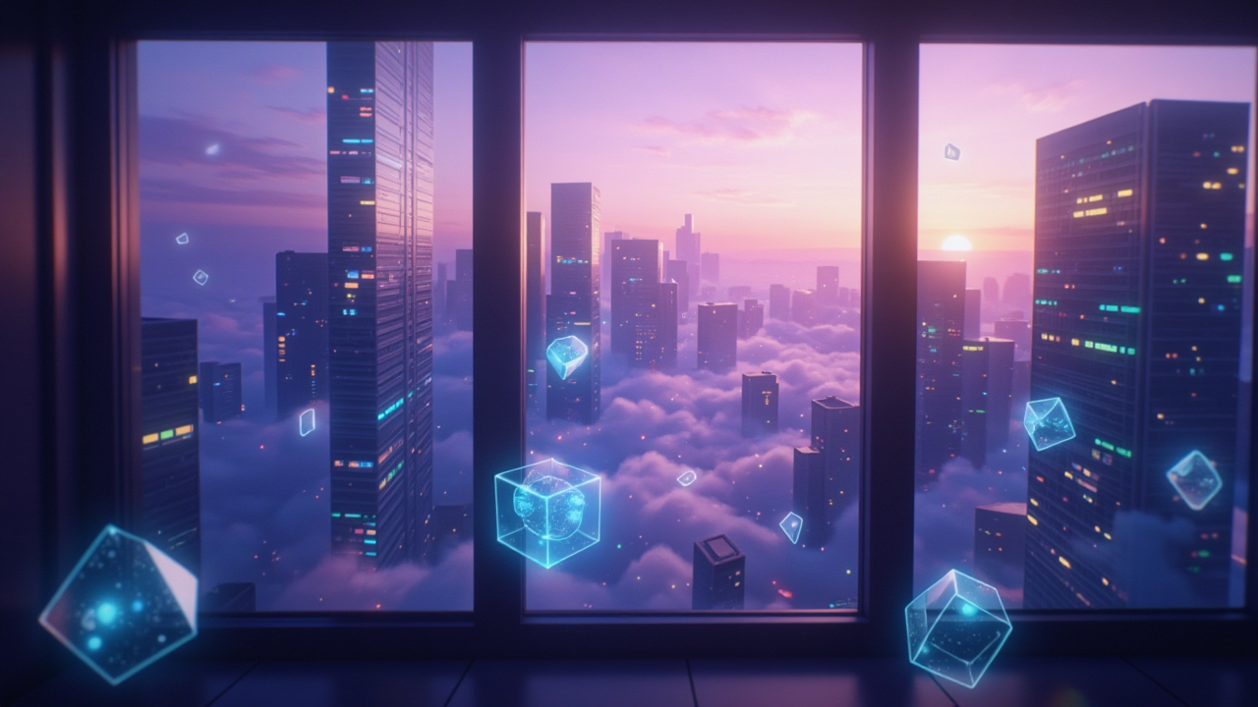
HW01 自我介紹
Notes:
Flux prompt:
A modern cityscape at dawn, viewed through a large window of a high-rise apartment. Tall skyscrapers with illuminated windows stretch into a gradient sky of deep purple fading into soft pink and orange. Multiple layers of holographic computer screens float in the air, displaying lines of glowing code in cyan and green. The window is slightly fogged, with drops of morning condensation. Scattered throughout the scene are geometric shapes - translucent cubes, spheres, and polygons - floating in the air, giving a technological yet dreamlike atmosphere. The cityscape is partially obscured by morning mist, creating a soft, ethereal effect. Minimal neon lights from distant buildings pierce through the dawn haze. The overall color palette focuses on cool tones - purples, blues, and teals - with warm highlights from the rising sun.

Slide 2
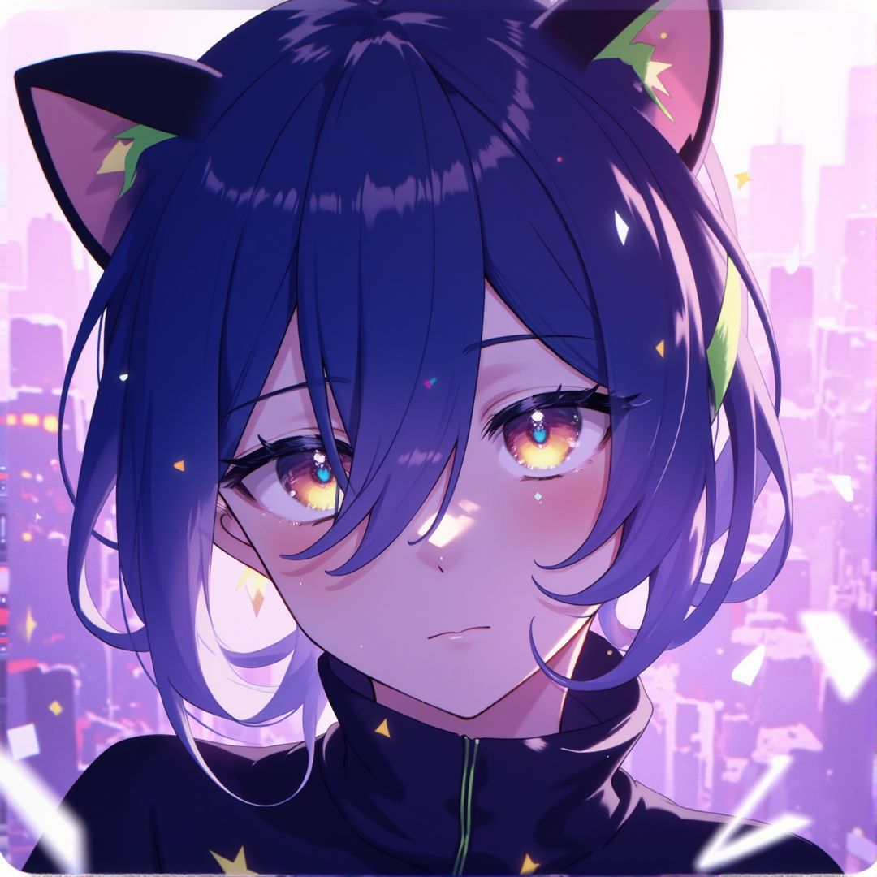
1. 目標
Notes:
Flux prompt: A close-up portrait of an anime-style character in a dreamy, urban-inspired background. The character is a young programmer with short, dark navy blue hair, accented by light green highlights at the tips. They have sharp, calm yellow eyes with a cat-like quality and a composed expression, reminiscent of quiet confidence. The character wears a high-necked, dark sweater that complements their mysterious and thoughtful vibe. They have black cat ears with light green accents at the tips and white tufts of fur inside, giving them a unique, gentle charm.
The background is a soft gradient of light purple and pink, designed to evoke a peaceful yet slightly melancholic mood, with subtle sparkles and floating geometric shapes, like code snippets or data bits, creating a surreal and introspective atmosphere. The city’s faint outlines can be seen in the background, with blurred details hinting at bustling crowds and ceaseless traffic—a nod to the character’s urban life filled with routines, problem-solving, and a search for fulfillment. The image style is smooth and soft, with delicate shading on the character’s face and hair, capturing their calm demeanor and inner contemplation amidst a life of monotony and quiet longing.

Slide 3
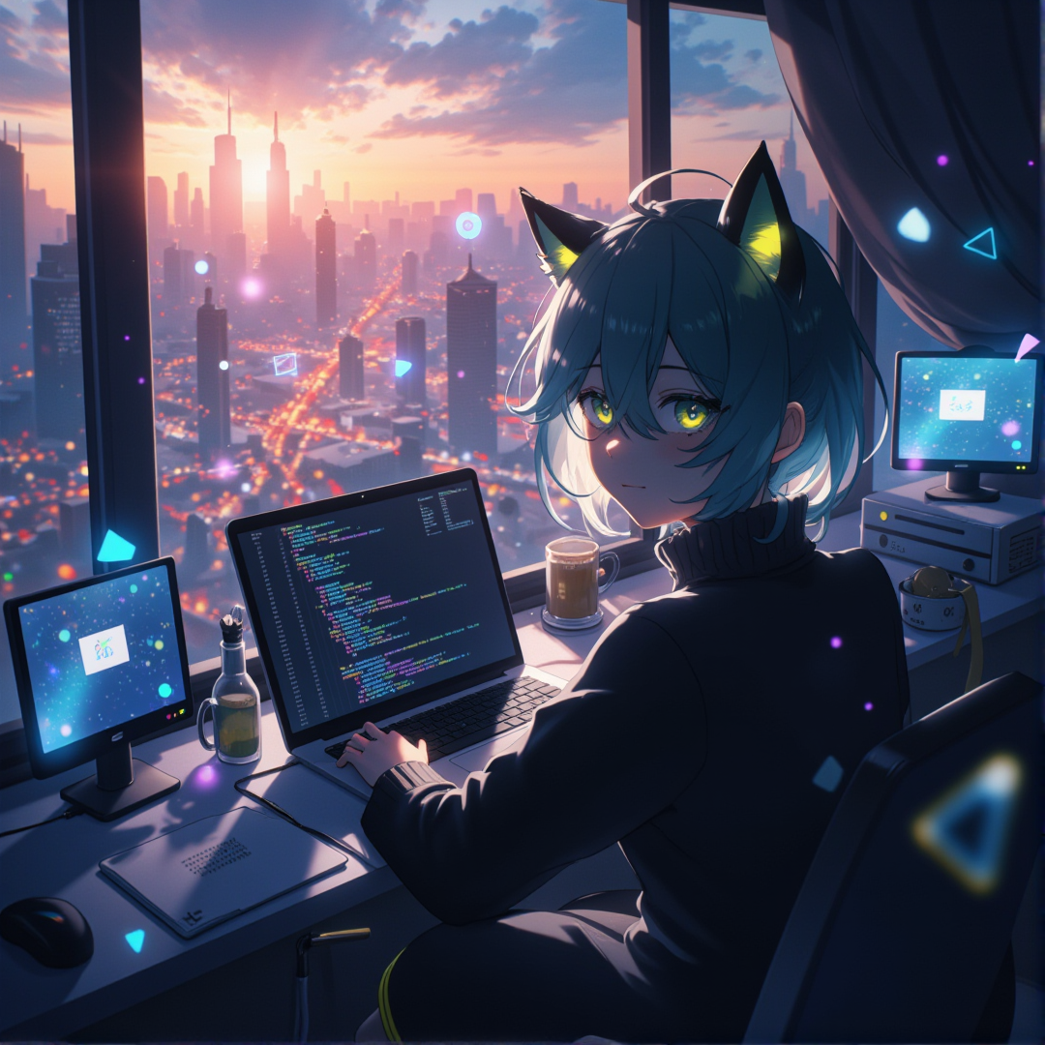
2. 阻礙
Notes:
Flux prompt: A melancholic anime-style portrait of a young male programmer in a modern city setting. He has short dark navy blue hair with light green highlights at the tips, striking yellow cat-like eyes, and black cat ears with light green accents. He's wearing a high-necked dark sweater and has a calm yet slightly lonely expression. The character is sitting by a large window in a high-rise apartment, with his laptop displaying lines of code casting a blue glow on his face.
The background seamlessly blends the interior and cityscape: Inside shows a minimalist modern room with a desk setup featuring multiple monitors, while through the window reveals a bustling city at dawn with towering skyscrapers, streaming traffic lights, and crowds of tiny people below. Floating around him are semi-transparent elements that represent his inner world: fragments of code, geometric shapes, and ghostly computer screens showing error messages.
The lighting creates a dramatic contrast - the warm orange sunrise from outside meets the cool blue light from his screens, creating purple shadows. Subtle sparkles and floating particles add a dreamy, ethereal quality to the scene. The overall atmosphere should convey both urban solitude and technological immersion, with a soft gradient that transitions from city lights to the intimate indoor space.
The art style should be smooth and soft with detailed shading, especially on the character's face and hair, emphasizing his feline features and contemplative expression. The composition should capture both his professional environment and his sense of isolation in the busy city.

Slide 4
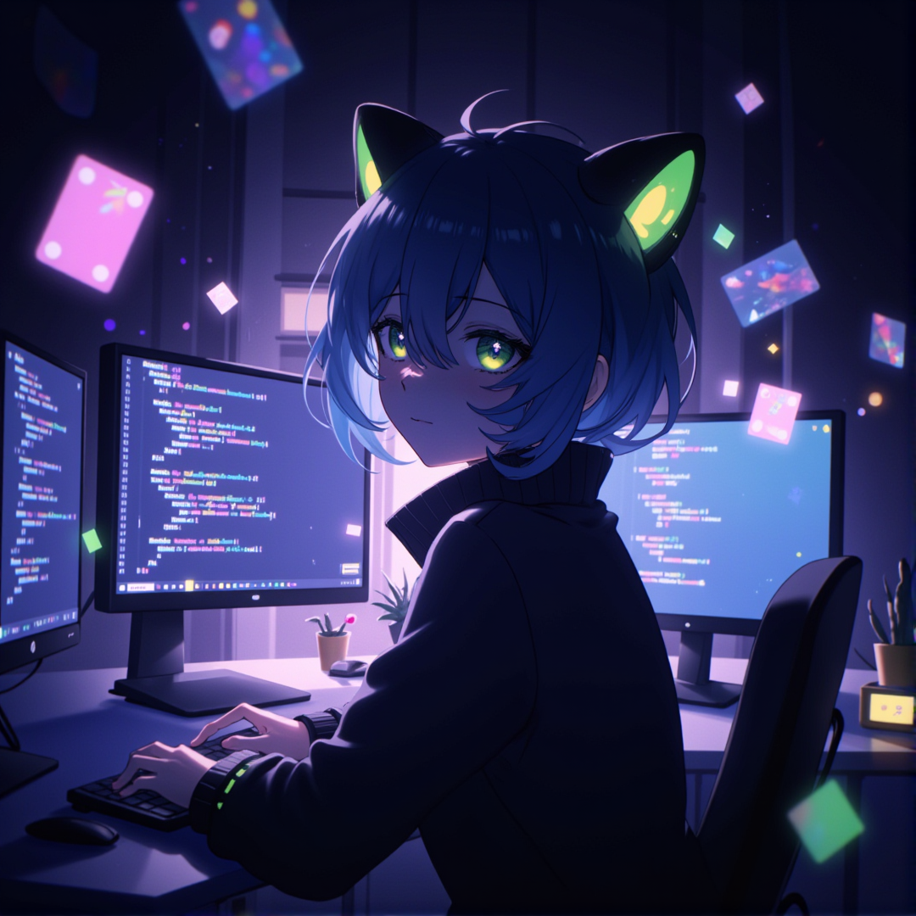
3. 努力
Notes:
Flux prompt: Create an illustration of a young male anime character sitting at a modern desk in his room at night. He has short navy blue hair with light green highlights at the tips, striking yellow cat-like eyes, and black cat ears with light green accents. He's wearing a dark, high-necked sweater and has a calm, focused expression. The character is illuminated by the soft glow of multiple computer monitors displaying code and social media conversations. The room's atmosphere is cozy and tech-oriented, with floating holographic UI elements showing GitHub repositories, chat messages, and code snippets in subtle purple and green hues. Geometric shapes and digital particles float in the background, creating a dreamy tech aesthetic. The lighting creates a dramatic contrast, with the monitors' blue light reflecting off his face, while warm ambient lighting adds depth to the scene. Small success indicators like notification popups and increasing follower counts are subtly visible on the screens, symbolizing his growing community presence. The overall style should be smooth and soft with detailed shading, maintaining an anime aesthetic while conveying a story of digital transformation and growing confidence.

Slide 5
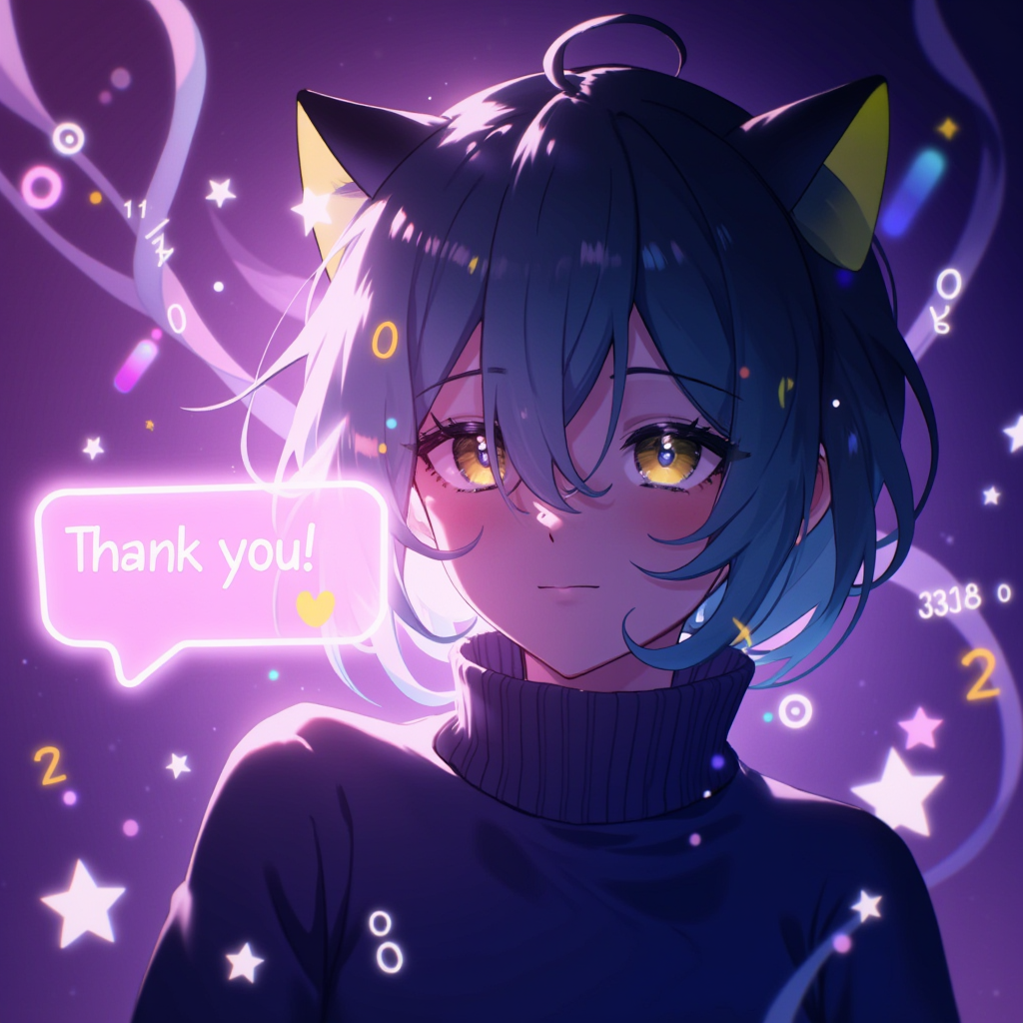
4. 結果
Notes:
Flux prompt: A heartwarming portrait of an anime-style male character with short navy blue hair with light green highlights, wearing a dark high-necked sweater. He has distinctive yellow cat-like eyes and black cat ears with light green tips. He's shown with a gentle, satisfied smile looking at a floating chat bubble.
A translucent, glowing chat message bubble floats beside him displaying 'Thank you!' in a warm, friendly font. The background features a modern tech workspace with soft holographic code elements in purple and pink tones. Gentle streams of binary code and programming symbols float in the space.
The atmosphere is dreamy and positive, with subtle sparkles and light particles floating in the air. The background incorporates a soft gradient of tech-inspired elements, creating a digital yet warm environment.
Style: Soft anime rendering with smooth gradients and delicate shading. The lighting creates a gentle, warm glow around the character and the floating message, emphasizing the meaningful moment.
Shot angle: Medium close-up shot focusing on the character's upper body and expression, positioned slightly to the left of center, with the chat bubble naturally floating to the right, allowing the tech elements to frame the composition.

Slide 6
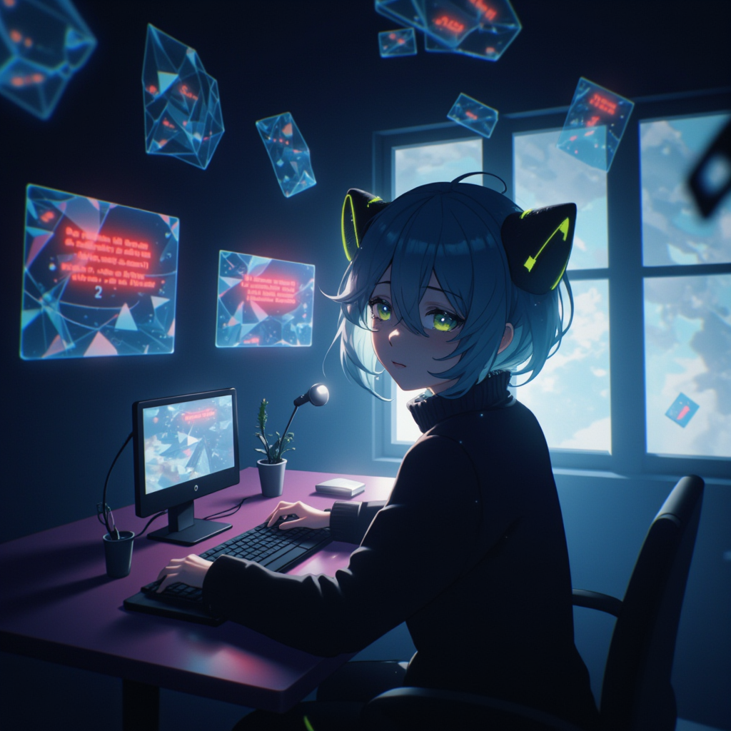
5. 意外
Notes:
Flux prompt:
A melancholic scene of an anime male character sitting alone at a computer workspace. The character has short navy blue hair with light green highlights at the tips, striking yellow cat-like eyes, and black cat ears with light green accents. He's wearing a dark turtleneck sweater and has a worried expression while staring at multiple floating holographic screens displaying error messages in red. The background is a modern minimalist room with dim lighting, where the main illumination comes from the blue-tinted screens. Floating geometric shapes and binary code patterns appear semi-transparent in the air, creating a tech-aesthetic atmosphere. The room's shadows are long and heavy, symbolizing the character's inner turmoil. The overall color palette consists of deep blues, cyber greens, and subtle purple undertones, with the error messages providing sharp contrasting red elements. Multiple screen reflections cast a digital glow on the character's face, emphasizing his distressed expression. The scene captures both the technological setting and the emotional weight of the moment, with some screens showing fragmented code and error symbols. Cinematic lighting, high quality, detailed rendering, dramatic atmosphere.

Slide 7
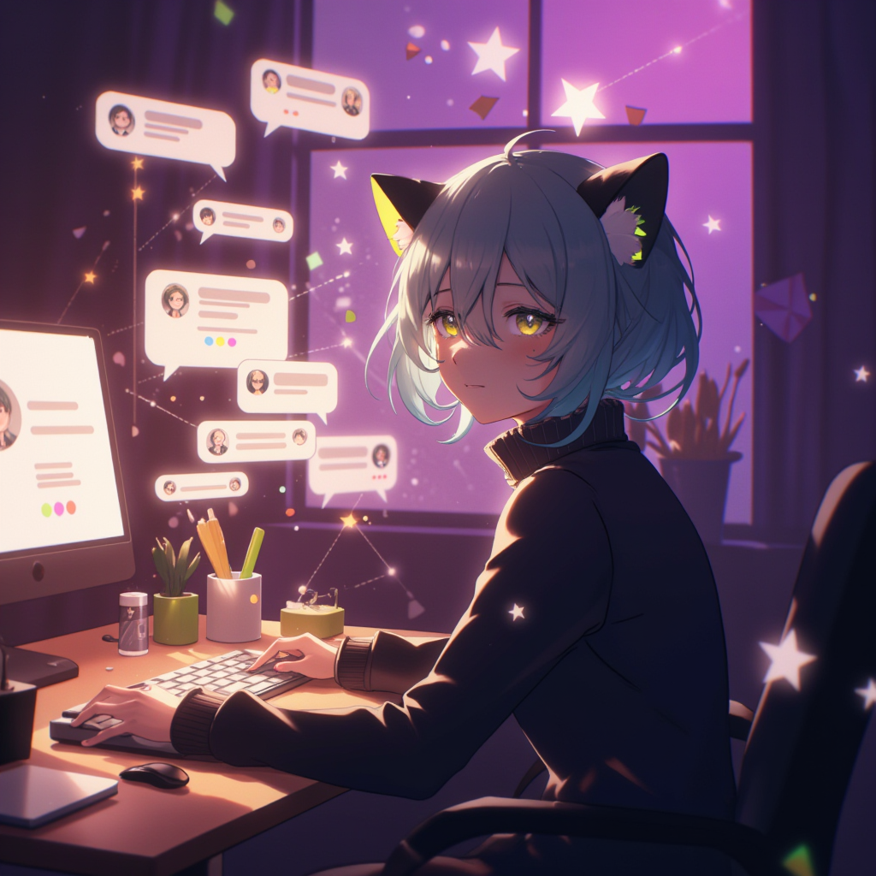
6. 轉折
Notes:
Flux prompt:
A warm, detailed illustration of an anime male character with short navy blue hair (light green highlights at tips) and expressive yellow cat-like eyes, sitting at a modern desk illuminated by a soft, warm glow. He's wearing a high-necked dark sweater, with black cat ears featuring green accents and white fur tufts. The character is looking at a holographic display showing multiple chat windows floating in the air, with gentle light particles emanating from the messages.
The background features a cozy tech workspace with floating digital elements: chat bubbles, connection lines, and soft geometric shapes creating a network pattern in shades of purple and pink. Multiple smaller screens display friendly avatar icons and supportive messages. Gentle light streams through a nearby window, creating a warm atmosphere that contrasts with the tech elements.
The scene is enhanced with subtle ambient lighting effects, creating a harmonious blend of digital and warm elements. Floating sparkles and geometric shapes add a dreamy quality to the atmosphere. The character's expression shows subtle relief and gratitude, with soft shadows and delicate shading across his features. The overall composition creates a balance between technology and human connection, with a smooth, soft art style that emphasizes the emotional warmth of the moment.

Slide 8
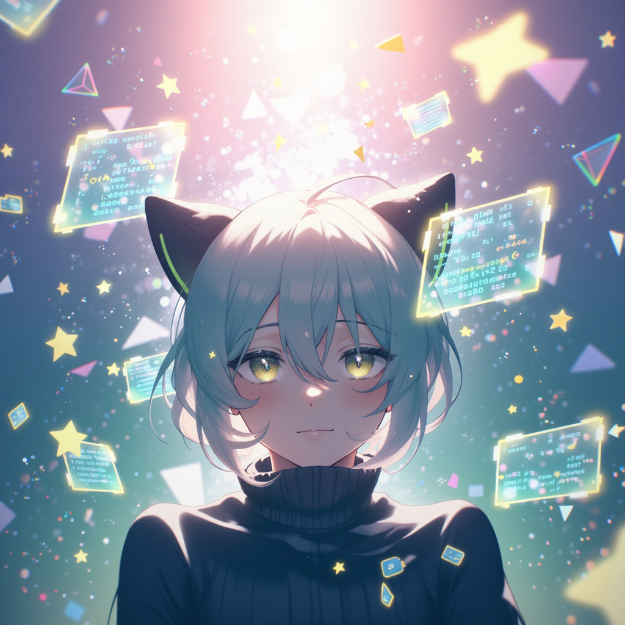
7. 結局
Notes:
Flux prompt:
A serene portrait of an anime male character standing in a modern tech workspace that transitions into a ethereal digital realm. The character has short navy blue hair with mint green highlights, sharp yellow cat-like eyes, and black cat ears with green accents. He's wearing a dark turtleneck sweater and has a peaceful, confident expression. The background transitions from a darker corner with binary code and circuit patterns, gradually bleeding into a brighter area filled with floating holographic screens, gentle light particles, and geometric shapes in shades of purple, pink, and mint green. Digital butterflies emerge from the dark corner, symbolizing transformation. Glowing lines connect various elements, creating a network of light. The character is surrounded by a subtle aura that shifts from deep blue to mint green, matching his hair. Soft ambient lighting creates a dreamy atmosphere while maintaining the technical elements. The overall composition suggests a journey from isolation to enlightenment, with the tech elements seamlessly blending into more organic, flowing forms. Style: anime, soft shading, high detail, volumetric lighting.

